Slide 1
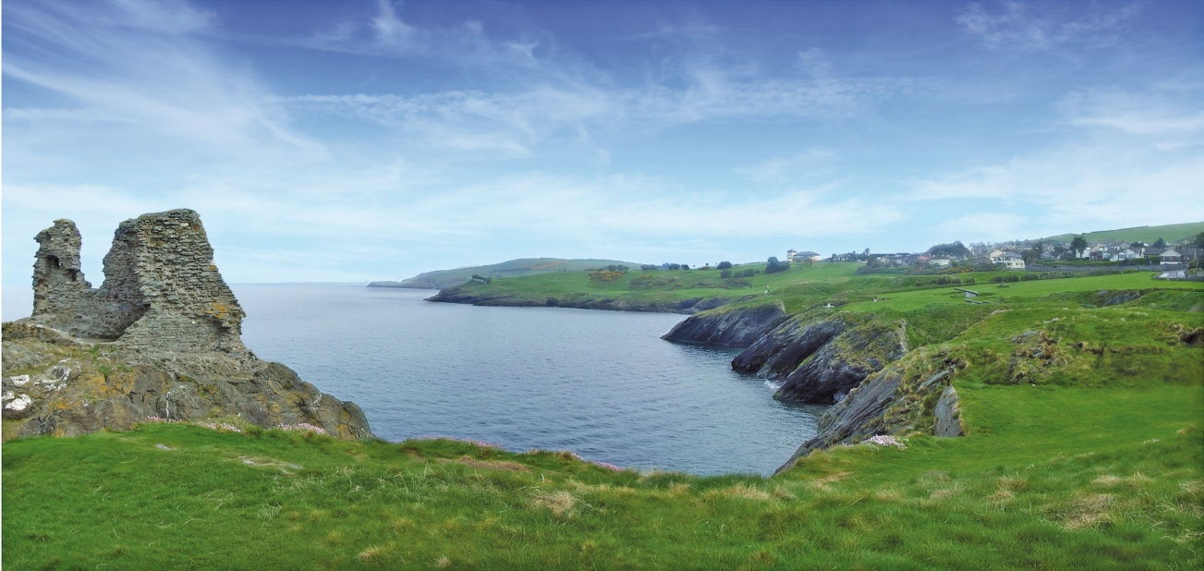
Irlandaustausch 2018
Notes:
1

Slide 2
Irlandbesuch vom 18.04.-24.04.2018 Rahmendaten Transfer
Hinreise:
Mittwoch, 18.04.2018
Treffpunkt Hauptbahnhof, Parkhaus am Quellenbach ca. 08.30 Uhr, Abfahrt: 8.50 Uhr (Transfer zum Flughafen mit Flixbus.de)
Hinflug Frankfurt/Main – Dublin (Lufthansa, Flug LH 980)
16.10 – 17.15 Uhr (eine Stunde Zeitverschiebung)
Transfer Dublin - Kilcoole , Dauer ca. 45 Min
Rückreise:
Dienstag, 24.04.2018
Abfahrt ca. 02.30 !! Uhr von Kilcoole
Rückflug Dublin Frankfurt/Main (Lufthansa, Flug LH 983)
05.55 – 08.50 Uhr, (Transfer vom Flughafen durch Fa. Lyst)
Ankunft Riemenschneider Gymnasium gegen Mittag
Notes:
2

Slide 3
Fluginformationen
Personalausweis oder Reisepass - 6 Monate Gültigkeit
Jede Person darf ein Gepäckstück bis max. 23 kg aufgeben.
Zusätzlich ist noch ein Handgepäck bis max. 8 kg (55*40*24 cm) erlaubt.
Siehe auch: https://www.lufthansa.com/de/de/Freigepaeck-Regeln
Bitte beachten Sie die Bestimmungen zum Transport von Flüssigkeiten:
Notes:
3

Slide 4
Notes:
4

Slide 5
Packliste
Personalausweis oder Reisepass - 6 Monate Gültigkeit
Adapter für elektrische Geräte (Nordeuropa/Irland)
Schreibblock/Stifte für Schulbesuch
Bekleidung für 6 Tage, feste Schuhe für Wanderung, warme (regendichte) Jacke/Schal
1 Gastgeschenk – hier ein paar Ideen:
Notes:
5

Slide 6
Notes:
6

Slide 7
Estimated Program Day 1 Wednesday
Day 1 – Wednesday April 18th
The Flight from Frankfurt will arrive in Dublin Airport @ 17.15 Terminal 1
A coach, accompanied by Mr Kennedy, will collect the students from the airport and take them directly to Coláiste Chraobh Abhann in Kilcoole.
Students to arrive at the school at 1900-1915
Students will have a brief welcome meeting with students and host families
The students will spend the remainder of the evening with the host family; this will involve a family meal and time to chat.
Notes:
7

Slide 8
Day 2 - Thursday
The students will have breakfast with the host family and attend school by travelling with the host student.
The host student and visiting student will need a packed lunch from the host family.
They will attend a range of classes until 10.25 and have their break until 10.45
At 10.45 the host students and visiting students will assemble in the GP area, to walk to the main street in Kilcoole to take the bus to Greystones.
The Students will walk to Bray taking the picturesque Cliff Walk.
They will have time to have their packed lunch in Bray and also to look around Bray beach.
The students will take the bus from Bray to Kilcoole.
The students will return to the school by approximately 3.55pm
They will have their evening meal with the host family
Notes:
8

Slide 9
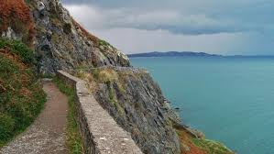
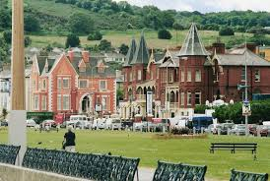
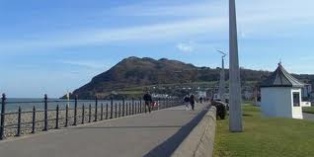
Notes:
9

Slide 10
Day 3 - Friday
The students will have breakfast with the host family and attend school by travelling with the host student.
The host student and visiting student will need a packed lunch from the host family.
They will attend a range of classes until 10.25 and have their break until 10.45
The host students and visiting students will walk to the main street in Kilcoole to take the bus to Greystones @ 11.15. They will travel from Greystones to Dublin by train and enjoy a visit to Trinity College, The GPO, The Four Courts and other tourist attractions followed by some time for shopping.
The students will return to Greystones at approximately 5.30pm and can be collected by the host families.
The remainder of the evening will be spent with the host family
Notes:
10

Slide 11
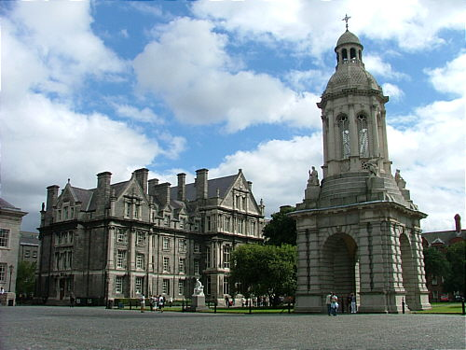
Notes:
11

Slide 12
Day 4 - Saturday
The student will spend the day with the host family.
They will have their meals with the host family and perhaps some shopping time.
The students will involve themselves in the usual activities that the family engages in on Saturdays.
The students will meet at the Diamond Bowl in Wicklow Town for Bowling at 8.30pm. They can be collected at 10.00pm from Wicklow Bowl.
Notes:
12

Slide 13
Day 5 Sunday
The students will spend the day with the host family.
They will have their meals with the host family.
The students may choose to meet up as a group and go to the cinema or do an activity with the host family.
Notes:
13

Slide 14
Day 6 - Monday
The students will have breakfast with the host family and meet at the school for 9.45am with the host student.
The host student and visiting student will need a packed lunch from the host family
The students will depart the school at 10.00am and travel to Wicklow Gaol for 10.30am. www.wicklowshistoricgaol.com
They will leave there at 11.00am and travel to Glendalough and visit the historical sights and complete one of the famous walks. Glendalough gets its name from the Irish language. Gleann dá Locha literally means the ‘Glen of the two lakes’. Situated right in the heart of the Wicklow Mountains National Park, Glendalough is one of the most visited locations in Ireland, with over 1 million visitors a year. Visit http://www.glendalough.ie/ View a video of Wicklow at https://www.youtube.com/watch?v=q7aOWd-Ac4U
Notes:
14

Slide 15
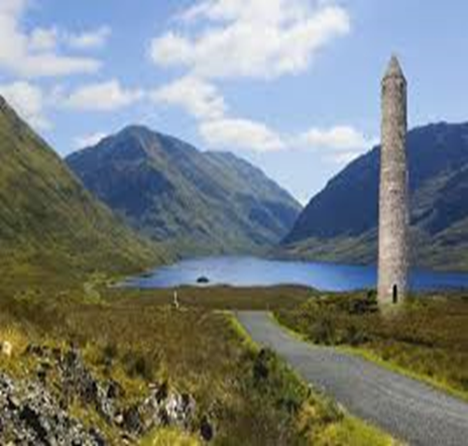
They will return to the school at 3.55pm.
They will have their final evening meal with the host family
and pack for their early morning flight.

Slide 16
Day 7 - Tuesday
Students will need to be dropped to the school for 3am for Departure to Dublin Airport for a flight at 6.00am.
Notes:
16

Slide 17
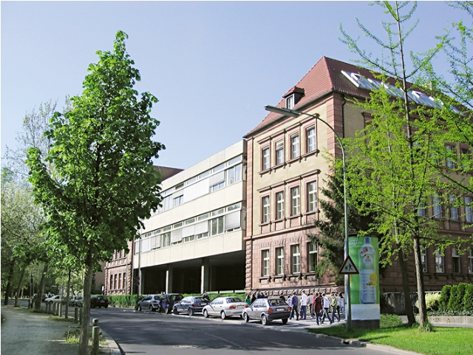
Besuch der Iren vom 09.05.- 14.05.2018 Vorläufiges Programm
Mittwoch, 09.05.:
Ankunft am RiG gegen 12.30Uhr
Empfang der irischen Gäste bei einem kleinem Imbiss in der Schule
Wanderung auf die Festung
Notes:
17

Slide 18
Donnerstag, 10.05.2018
Treffpunkt in der Schule um 10.00 Uhr
Radtour in der Umgebung Würzburgs
Mittagessen auf dem Schulgelände
Zeit zur freien Verfügung in den Familien
Notes:
18

Slide 19
Freitag, 11.05.2018
Schulbesuch in der ersten beiden Stunden
Offizielle Begrüßung durch den Schulleiter
Empfang im Rathaus zur Feier des 10-jähirgen Jubiläums des Irlandaustausches
anschließend Stadtbesichtigung in Kleingruppen
Notes:
19

Slide 20
Samstag, 12.05.2018
Kletterwald Einsiedel 10.00-13.00 Uhr
Bitte Lunchpaket mitnehmen und an Handschuhe, Sportkleidung und Sportschuhe denken
Nachmittags/Abends: Zeit zur freien Verfügung
Notes:
20

Slide 21
Sonntag, 13.05.2018
Zeit in den Familien
Notes:
21

Slide 22
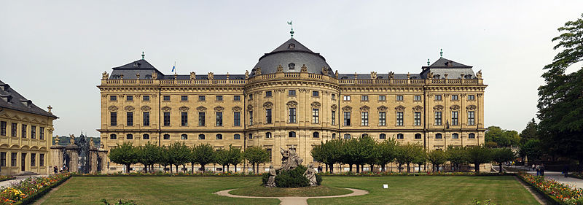
Montag, 14.05.2017
Englischsprachige Führung durch die Residenz für die irischen Gastschüler
13.30 Uhr Abschlusszeremonie an der Schule
Abfahrt um 14.50 zum Flughafen: Treffpunkt um 14.30 am Bahnhof
Notes:
22

Slide 23
Hinweise
Eltern haben außerhalb der Schulveranstaltungen die volle Aufsichtspflicht.
Bitte informieren sie die begleitenden Lehrkräfte über eventuelle Erkrankungen!
Bitte das Jugendschutzgesetz beachten!
(Alkoholkonsum, Aufenthalt in Gaststätten und Diskotheken bis 24.00 Uhr)
Bei Fragen und Problemen bitte an Herrn Barthel (0163/
9808818) oder Frau Haaf (0174/3712123) wenden.
Notes:
23

Slide 24
Wir freuen uns auf den Austausch und hoffen auf gutes Gelingen!
Herbert Barthel und Sibylle Haaf
Notes:
24

